Slide 1

RAW DATA TO ACTIONABLE INSIGHTS
A Custom NBA Award Analytics Pipeline
2019-20 to 2024-25 • PostgreSQL • Power BI • Custom Percentile Scoring Engine
VJ | Data Analytics Portfolio Project

Slide 2



STAGE 1
Data & Infrastructure
Data Source
Database Engine
Visualization
Basketball Reference, cleaned and staged via CSV — 6 full NBA seasons (2019-20 through 2024-25)
PostgreSQL + pgAdmin. Fact/dimension schema: player and team season facts keyed to player, team, and season dimensions
Power BI (Import mode). 7 dashboards covering player and team grain — season, comparison, and progression views

Slide 3




STAGE 2
Methodology
Percentile-Based Scoring
Every stat ranked within its own season — not against a fixed historical baseline that drifts as pace and style change.
Weighted Addition, Not Multiplication
Composite scores sum proportional contributions. Multiplicative scoring was tested, collapsed toward zero, and discarded.
Minutes & Games Floors
1,000-minute threshold (600 in shortened seasons) prevents small-sample rate stats from producing indefensible winners.
65-Game Eligibility Rule
Mirrors the real NBA's 2023-24 award eligibility policy, introduced in response to load-management concerns.
Full reasoning, formulas, and worked examples live in the companion methodology report.

Slide 4

STAGE 3
Engineering Judgment: What Got Cut, and Why
MIP
6MOY
Delta-percentile calculation proved statistically unfixable across season boundaries.
Box-score data can't reliably isolate bench scorers from rotation players.
Early “Best Defensive Player” Metric
All-Rookie / All-Defense / All-Off. Team
Rate-stat inflation at low minutes produced winners that weren't defensible.
Mathematically redundant with DPOY and OPOY once cutoffs were widened.
Dropped rather than shipped with an asterisk.

Slide 5
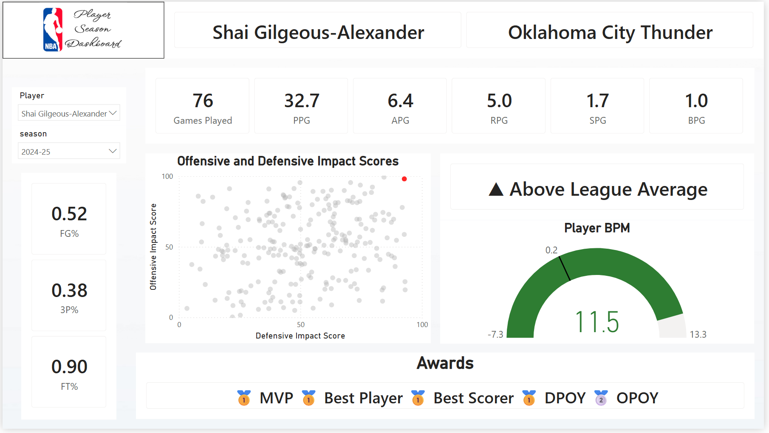
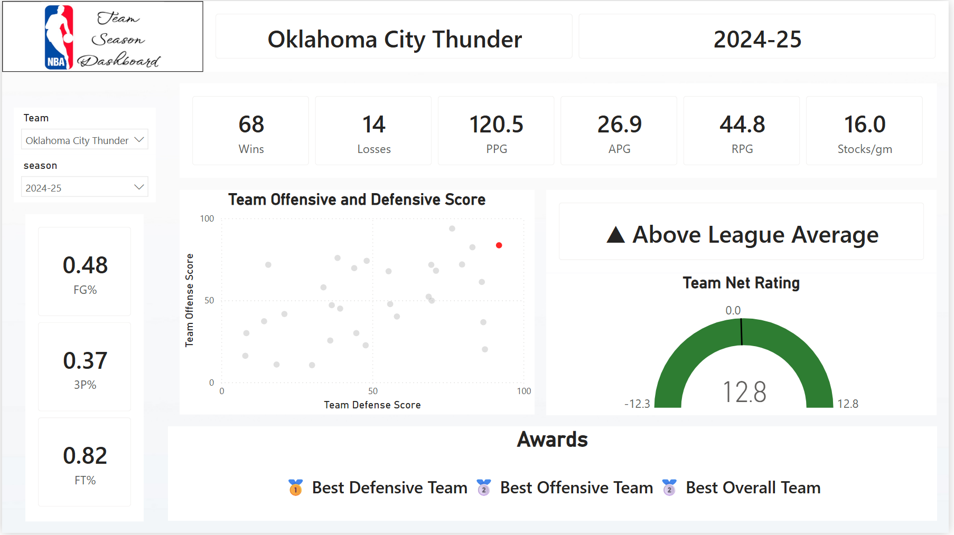
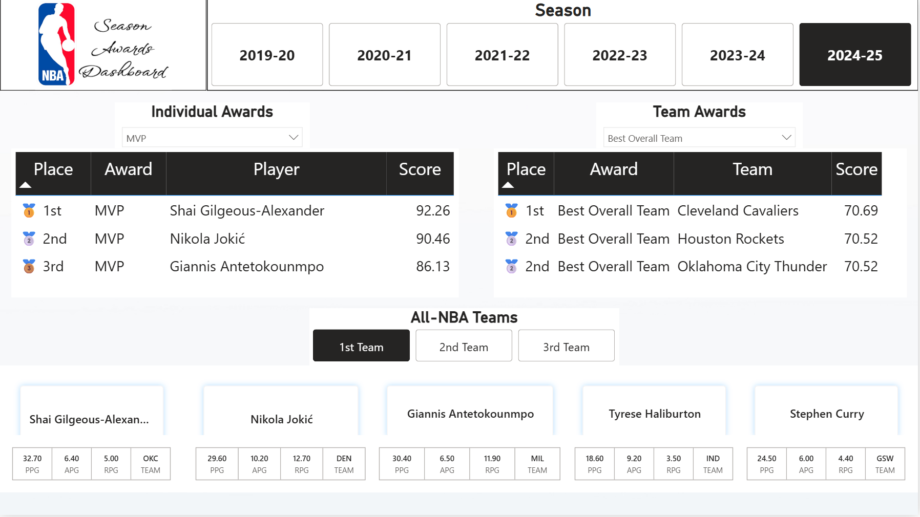
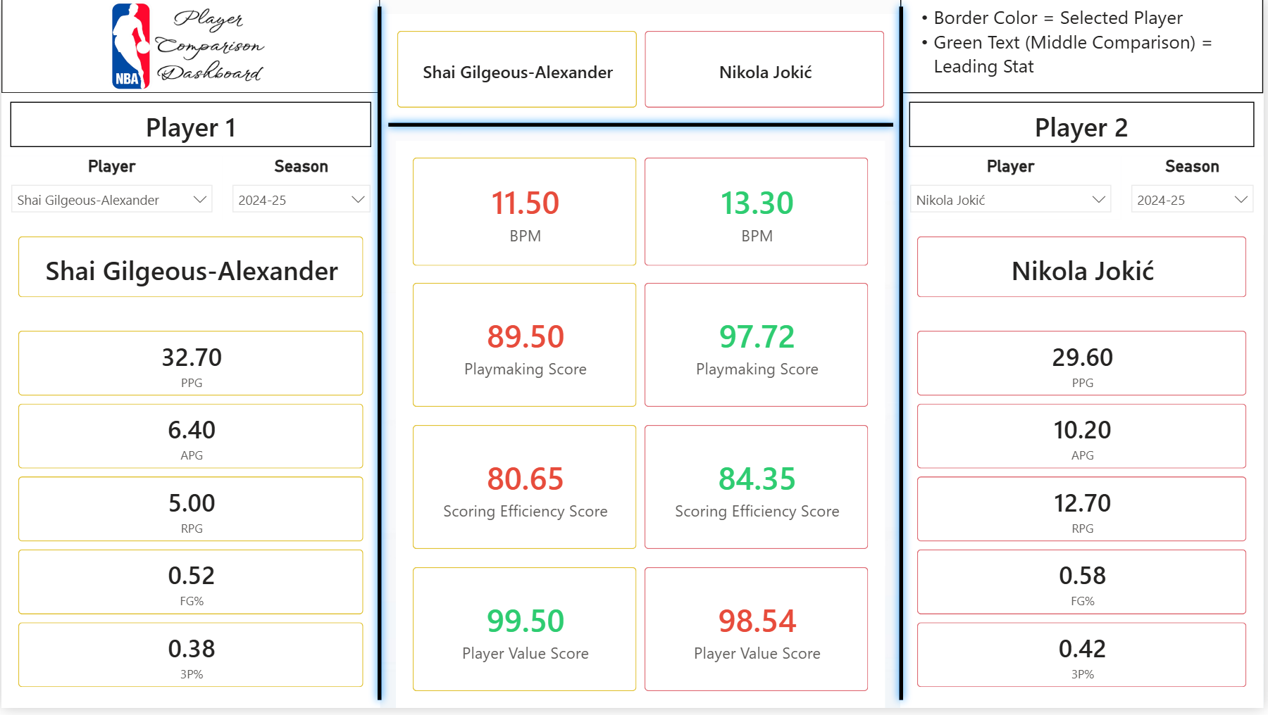
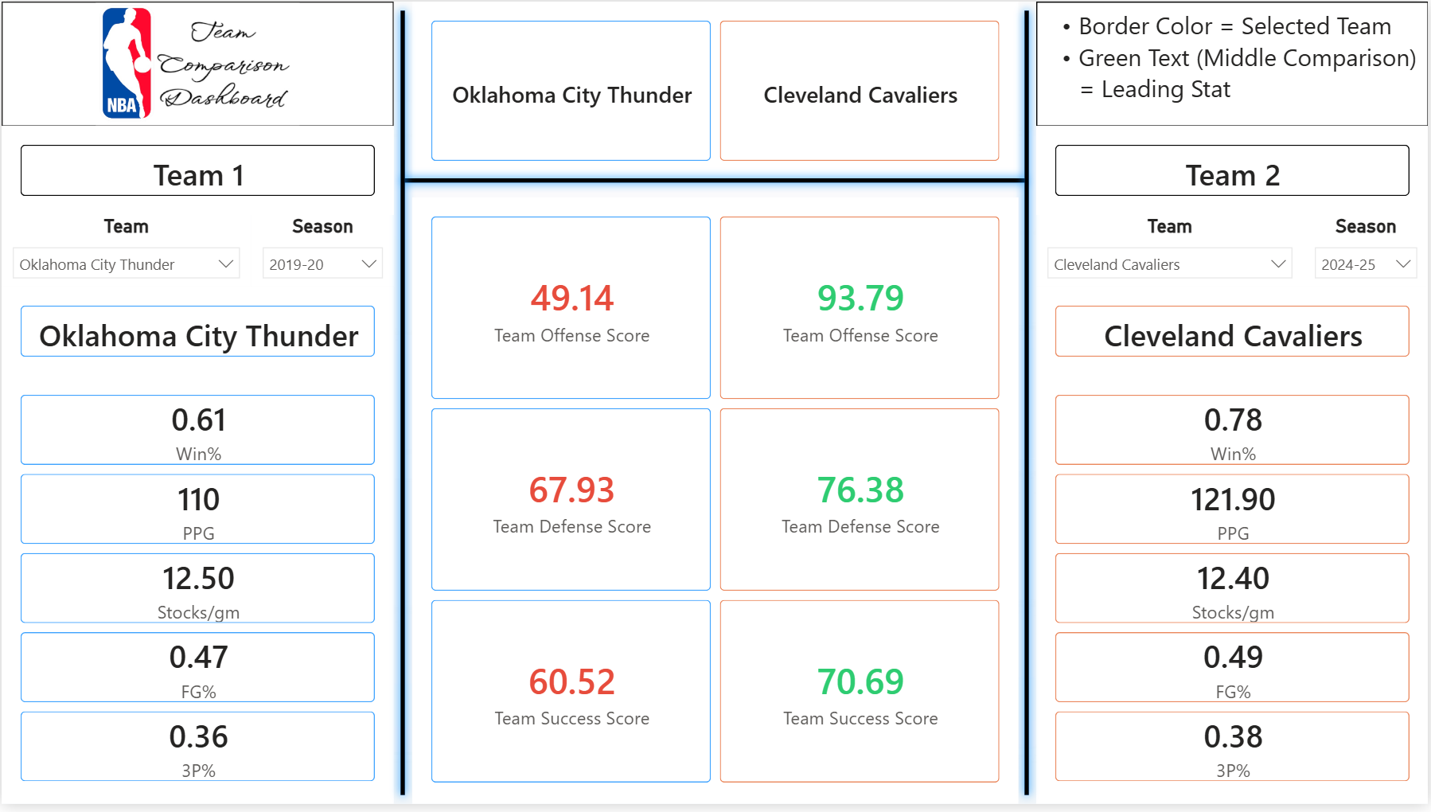
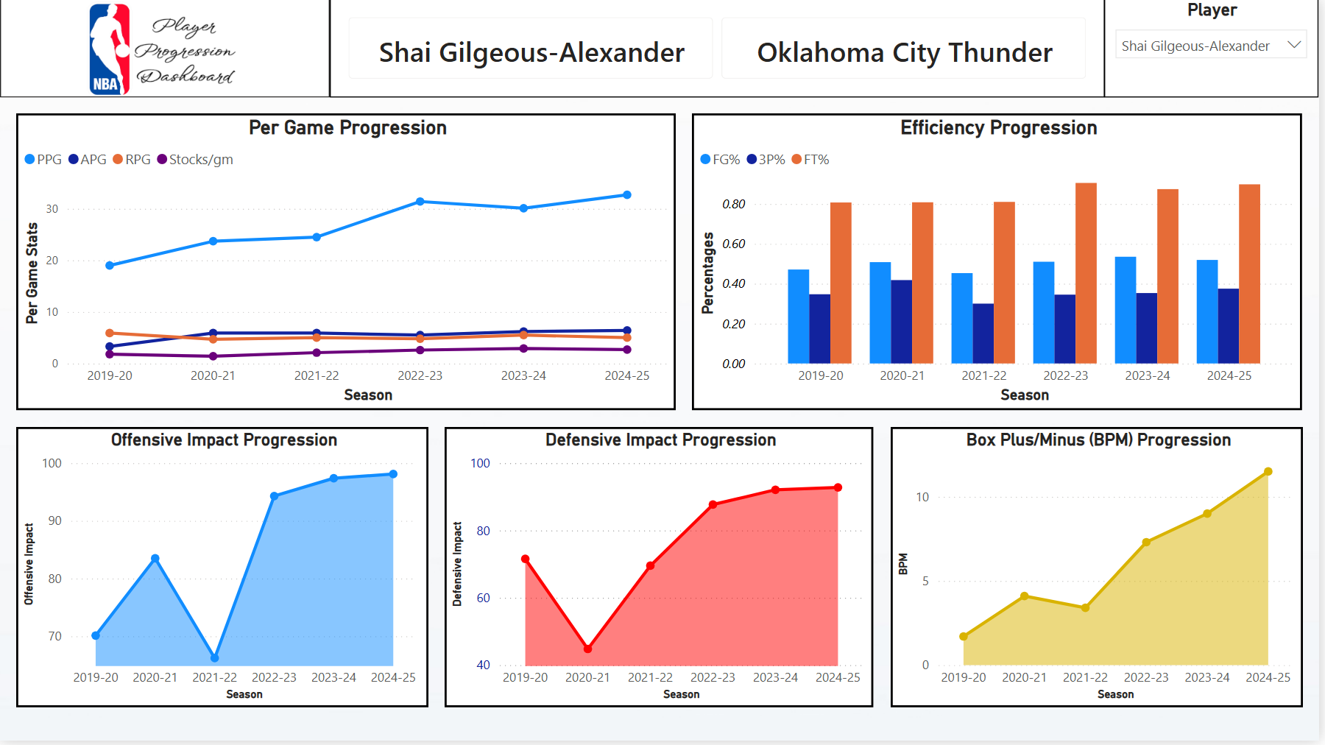
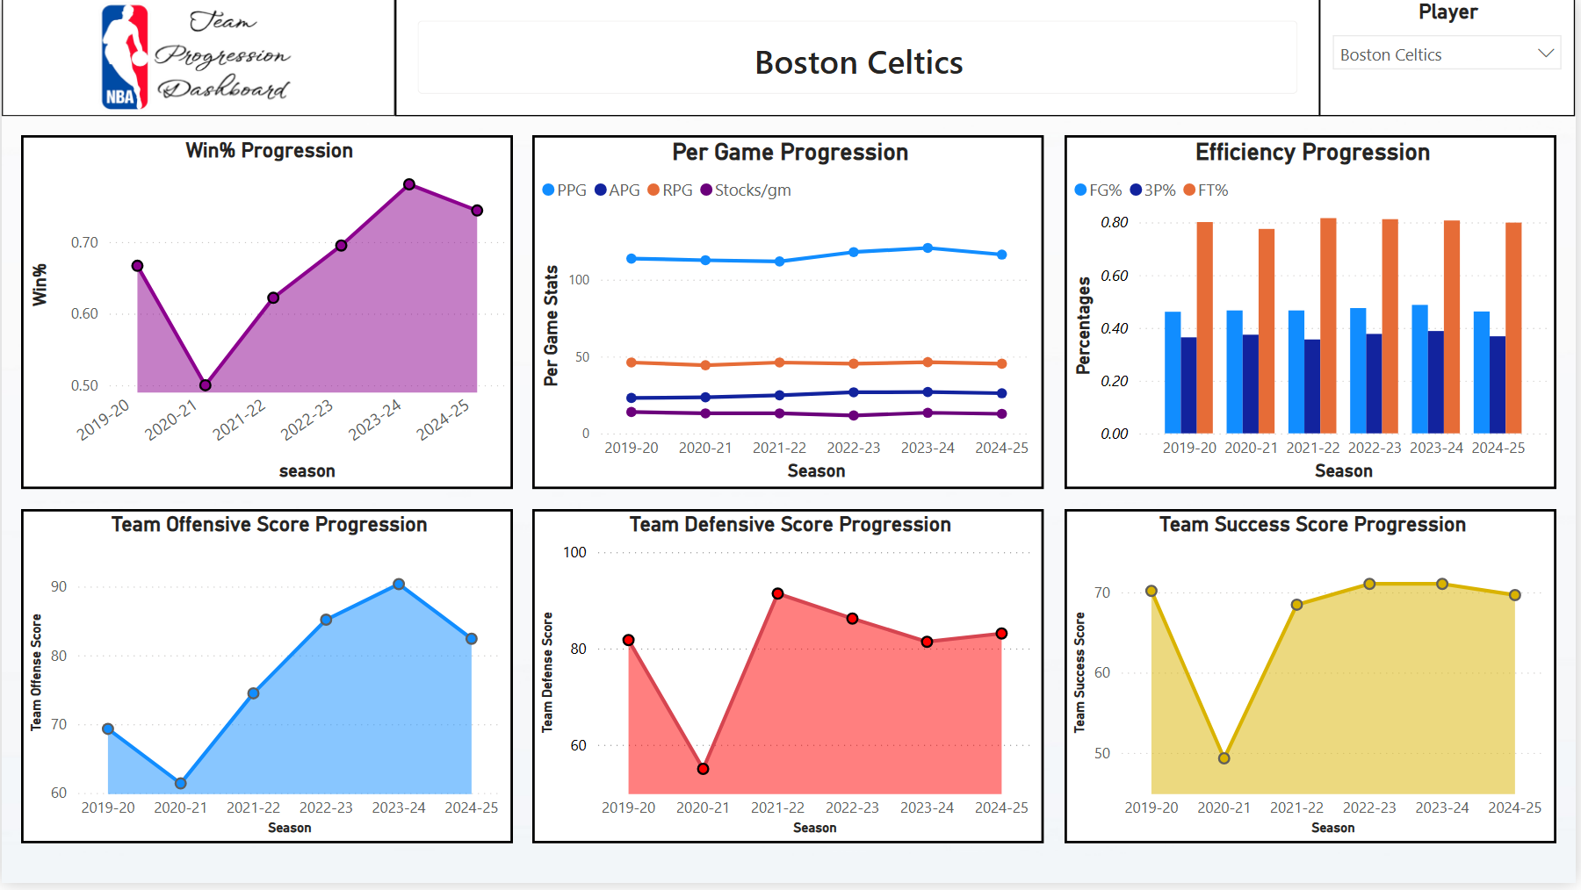
STAGE 4
Power BI Dashboards
Player Season
Team Season
Season Awards
Player Comparison
Team Comparison
Player Progression
Team Progression
All 7 dashboards, built on a shared data model — player and team grain, season, comparison, and progression views.

Slide 6
STAGE 5
Validation — Does It Match Reality?
A “deserved” winner only means something if it's checked against basketball reality — confirmed against live query results on both counts below.
2019-20 Best Defensive Team
OKC 2024-25 — Defensive Outlier
1
Bucks
92.07
Team Defense Score
91.90
2
Raptors
86.72
Net Rating
+12.8
3
Lakers
85.52
Record
68–14
Both checks confirmed against live query results — calculated outputs match known basketball reality.

Slide 7


What This Demonstrates
Database Design & SQL Engineering
Normalized fact/dimension schema, layered view dependencies, all calculation logic in SQL
Statistical Methodology & Metric Design
Percentile-based scoring, weighted composites, era- and sample-size-aware adjustments
BI Dashboard Development
7 Power BI dashboards across player and team grain, built from a shared data model
Engineering Judgment
Willingness to redesign or cut metrics that couldn't produce defensible results
Full methodology: companion R report | Full project: GitHub repository

